Slide 1
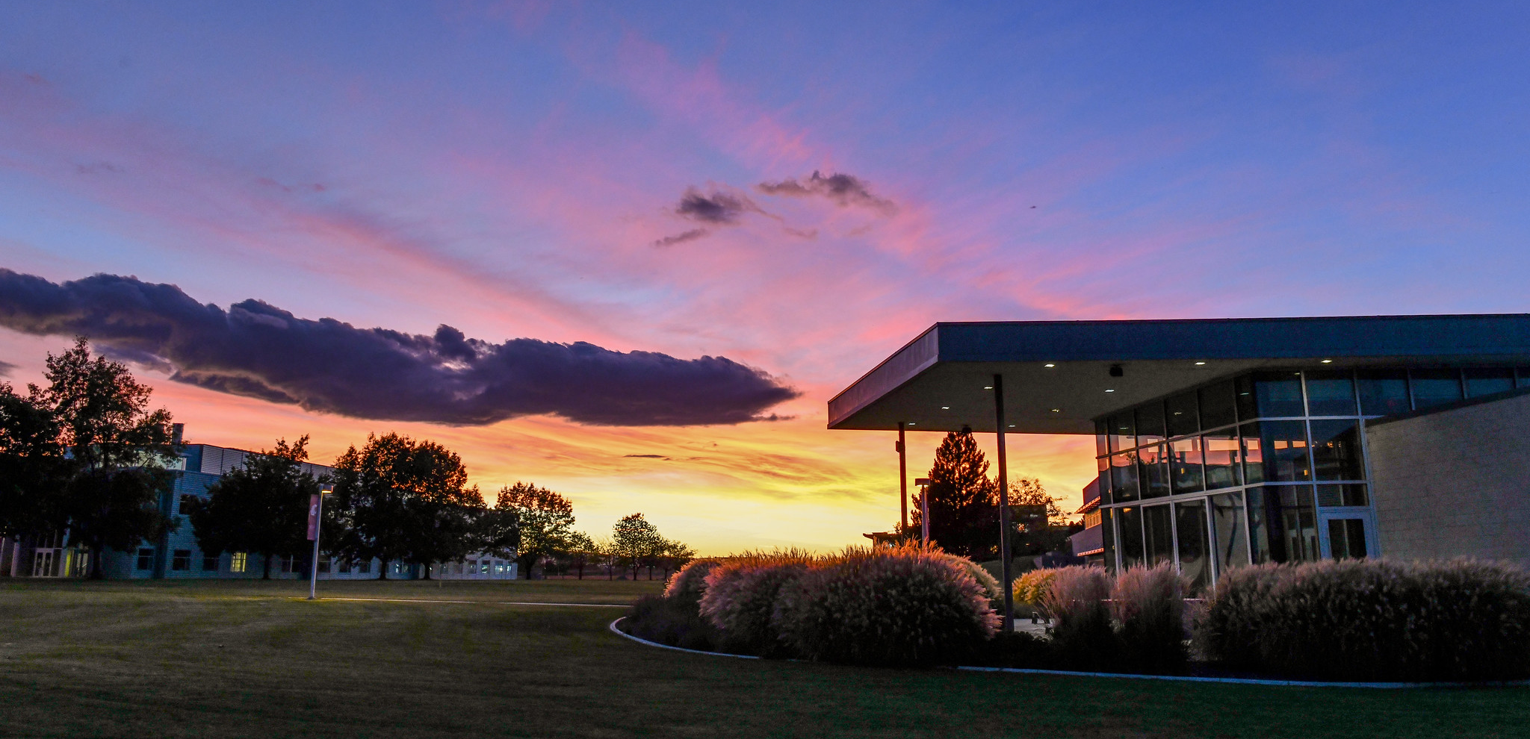

Fall Update
Notes:
Good afternoon, Tri-Cities COUGS! I am happy to have this opportunity to speak with you all today. It was so good to see many of you driving by for goodies---including this mug designed by our very own Mo Van Sant. I admit that I would much rather be delivering this address in person, as I miss the interaction with each and every one of you. I am, however, grateful for the technology that brings us together and has sustained our operations over the past 7 months.
It’s been a busy 7 months to say the least; busier than ever for many of us, as we have adjusted to being at home-- working, often with others in the house doing the same or attending school. It has been a challenge unlike any other in our lifetimes. Having said that, I am extremely proud of the way in which our campus community has risen to the occasion and continues to support our students and each other through these trying times.
When your registered for this event, we asked if you had any questions. We have incorporated answers to those questions into this speech. If other questions arise, put them in the Q&A function and they will be answered by the experts who are standing by behind the scenes! So here we go!

Slide 2

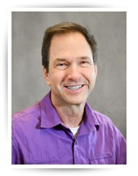
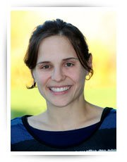
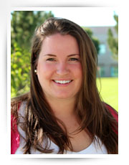
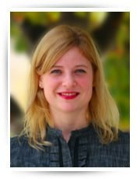
Faculty Promotions
Robert Bauman
Professor
History
Mark Mansperger
Professor
Anthropology
Vanessa Cozza
Associate Professor
English
Janet Peters
Associate Professor
Psychology
Elly Sweet
Associate Professor
Biology
Notes:
A virtual round of applause for all of our new, promoted, and award winning Cougs!

Slide 3
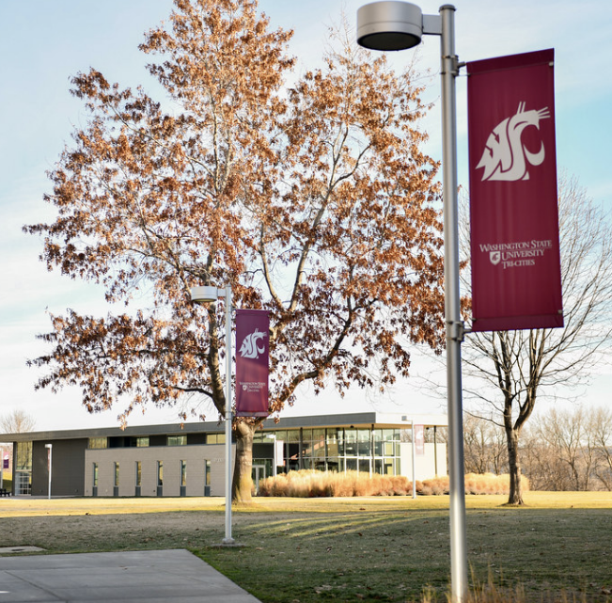
New Faculty
Kersten Bergstrom
Lecturer of Biology
Robert Franklin
Lecturer of History
Angela Hamel
Assistant Clinical Professor, Nursing
Notes:
A virtual round of applause for all of our new, promoted, and award winning Cougs!

Slide 4
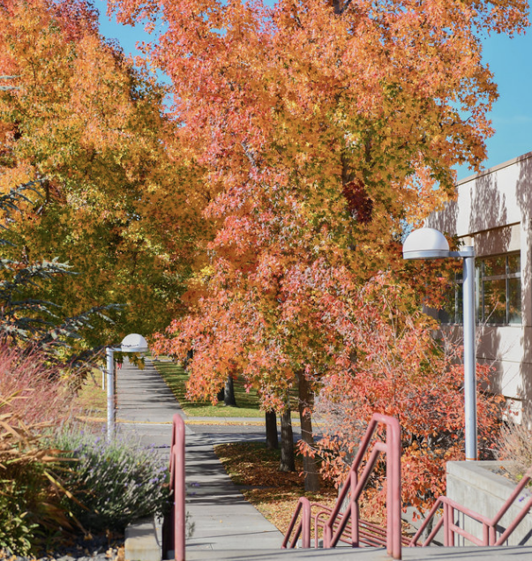
Chancellor’s Office
Heather Cova
Chief of Staff
Claire Venema
Assistant to the Chancellor for Constituent Relations and Communications
Notes:
A virtual round of applause for all of our new, promoted, and award winning Cougs!

Slide 5
Finance & Administration
Gabby Armatis
Office Assistant
Finance & Administration
Ryan Bailey
Utility Worker
Facilities
Ronald Beach
Grounds and Nursery Services Specialist
Chris Beecher
Personnel & Payroll Specialist
Becky Gubser
Principal Assistant for Finance and Administration
Molly Levy
Personnel & Payroll Specialist
Michael Nix
Custodian
Loreen Olds
Procurement & Supply Specialist
Notes:
A virtual round of applause for all of our new, promoted, and award winning Cougs!

Slide 6
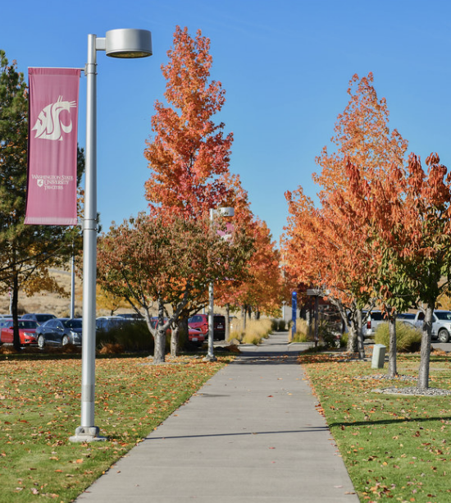
Human Resource Services
Koren Harrison
Human Resource Consultant
Kelsey Morris
Human Resource Analyst
Notes:
A virtual round of applause for all of our new, promoted, and award winning Cougs!

Slide 7
Academic Affairs
Jill Andrews-Prior
Nursing Preceptor
Laura Follett
Teaching Assistant Professor
Angela Hamel
Clinical Assistant Professor
Mathew Jensen
Program Coordinator
Jennifer Larson
Teaching Assistant Professor
Shirley McIntosh
Teaching Assistant Professor
Sarah Minter
Academic Advisor
Rubayet Mortuza
Teaching Assistant Professor
Cody Thompson
Viticulture and Enology Coordinator
Florentino Valdez
Research Technologist for Viticulture and Enology
Che-Hao Yang
Teaching Assistant Professor
Allison Young
Teaching Assistant Professor
Notes:
A virtual round of applause for all of our new, promoted, and award winning Cougs!

Slide 8
Community Outreach - GEAR UP, 21st Century, Upward Bound
Christine Carpenter Office Assistant for Outreach and GEAR UP at Othello High School
Noelia Causor
Upward Bound Program Coordinator
Pedro Cordoba
Student Achievement Specialist
Guadalupe Ochoa
Site Manager for GEAR UP
Kimberly Ostrowski
Site Manager for GEAR UP
Felicity Peery
Academic Specialist
Thalia Quintero
Site Coordinator for GEAR UP
Jocelyn Reyes
Managing Director of 21st Century Community Learning Centers
Rachael Robertson
Student Achievement Specialist
Celia Vargas
Student Achievement Specialist
Notes:
A virtual round of applause for all of our new, promoted, and award winning Cougs!

Slide 9
Student Affairs
Andrea Aldous
Financial Aid & Student Services Coordinator
Jessica Bland
Academic Schedule Coordinator, Registrar Office
Kristine Cody
Director of Career Services
Gloria Van Egdom
Admissions Counselor
Deena Richter
Assistant Registrar/VA Certification Official
Jennifer Silvia-Gutierrez
Program Coordinator
Sylvia van Breda Vriesman
Student Counselor and Wellness Coordinator
Tatiana Vazquez
Admissions Counselor
Maria Zuniga
Admissions Counselor
Gretchen Hormel
Access and Financial Aid Coordinator
Evelyn Martinez
Assistant Director of Student Engagement and Leadership
Karina Barajas
Executive Assistant and International Student SEVIS Coordinator
Notes:
A virtual round of applause for all of our new, promoted, and award winning Cougs!

Slide 10
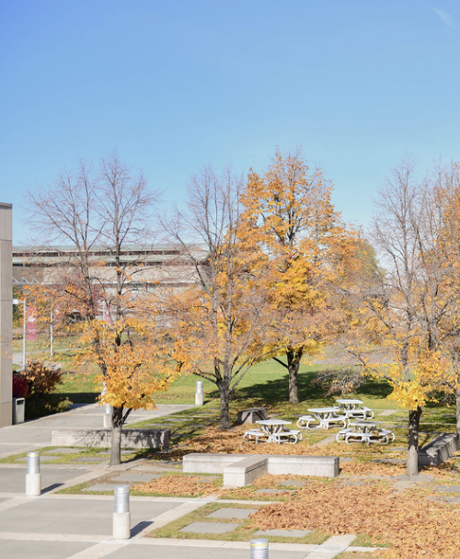
College of Medicine
Amanda Doyle
Medical School Assistant
Notes:
A virtual round of applause for all of our new, promoted, and award winning Cougs!

Slide 11

Notes:
A virtual round of applause for all of our new, promoted, and award winning Cougs!

Slide 12
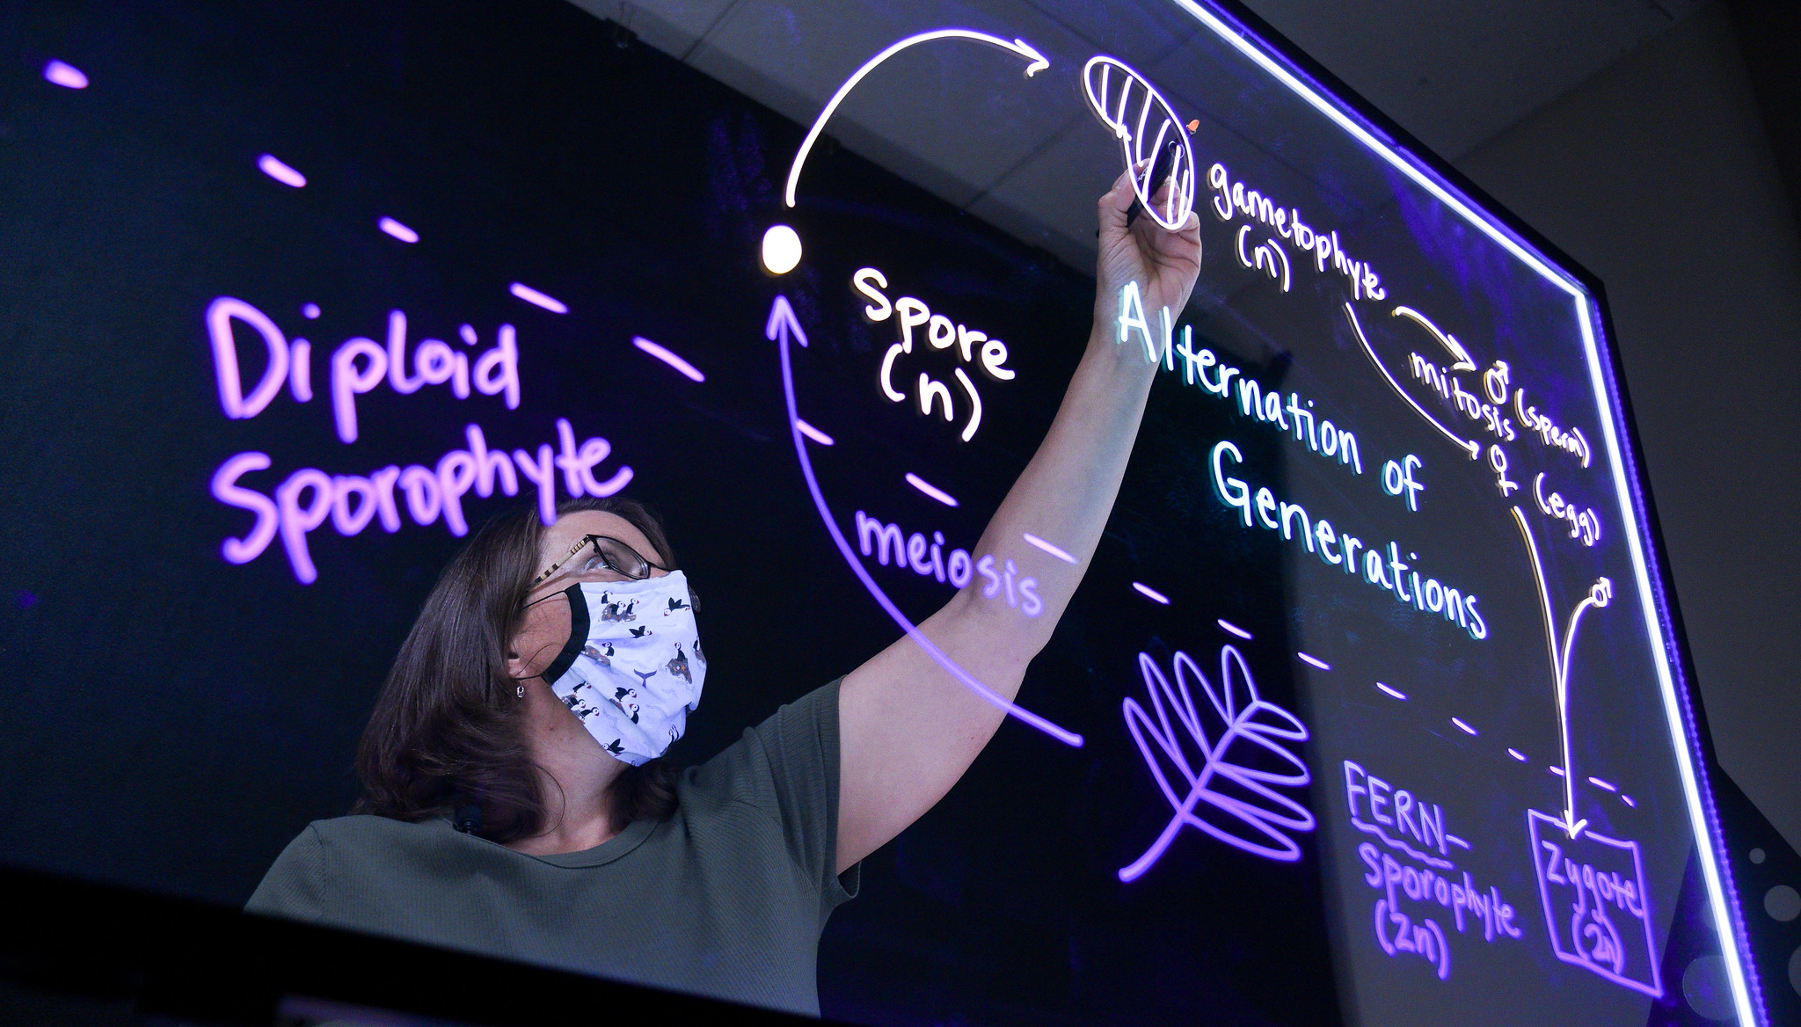
Transition to Virtual Learning
Notes:
Let’s now look at a smattering of things we have accomplished, despite the trying times around us. One of the most amazing accomplishments of the year was the way in which faculty adjusted to alternative course delivery models in March. It is important to note that the adjustment was not just a quick pivot to virtual learning. Faculty participated in Academic Outreach and Innovation’ trainings to prepare for state-of-the-art distance course delivery using technology such as Panopto for lecture capture and for exceptional pedagogical practices such as using inclusive design for instruction or flipping a classroom.
Our own Janet Peters offered trainings as well via the innovative instruction center here in Tri-Cities including on how to use my new favorite technology, learning glass. Learning glass enables face-to-face engagement when writing on a glass board allowing videos to appear as if you are in the same room with your audience. Dr. Peters also started Friday morning coffee chats with faculty to assist with their questions around remote teaching and learning.
I am so very impressed with the ways in which faculty continue to improve the learning experience for our students.

Slide 13
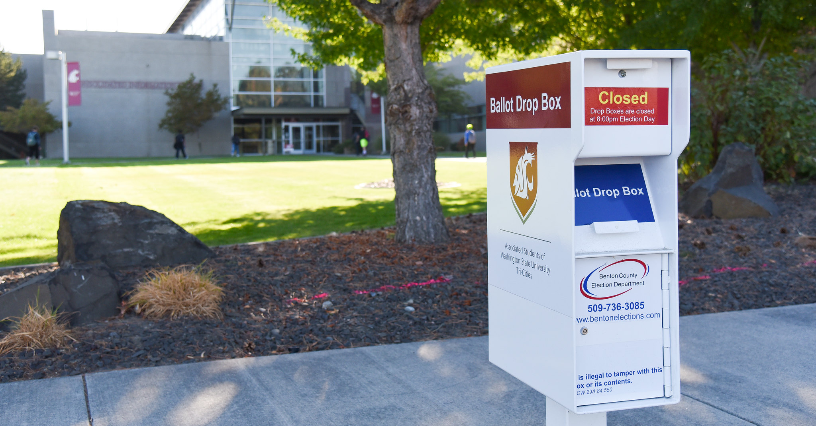
American Democracy Project, Student Engagement Hub
Notes:
Last September, the campus was awarded a proposal to participate in the American Association of State Colleges and Universities (AASCU) American Democracy Project (ADP) initiative, “Understanding Engagement in Times of Crisis”. The American Democracy Project is a network of nearly 300 colleges and universities focused on public higher education’s role in preparing the next generation of informed, engaged citizens for our democracy. I can think of no better time to be joining this project with our pending elections, debates about the role of the government in our lives in a crisis, and the events of the summer that have caused us to reconsider racism and the role of protest in our society.
Speaking of election season, ASWSUTC has worked with the Office of Student Engagement and Leadership and the Benton County Auditor’s Office, on the implementation of the new, state-mandated Student Engagement Hub. Located on campus from October 29th to November 3rd, individuals can come to campus to print their ballot, register to vote, have questions answered by Benton County election staff, and, of course, use the ballot drop box in the CIC parking lot. As a subscriber to the “Campus Democracy All In Presidential Challenge” to facilitate more participation in our democracy, I am impressed with the work our students have done to establish this important center for our campus and the community.
As we approach the election, please be sure to follow campus social media channels and newsletters for more information about how to participate and promote civic engagement, and please, please vote.

Slide 14
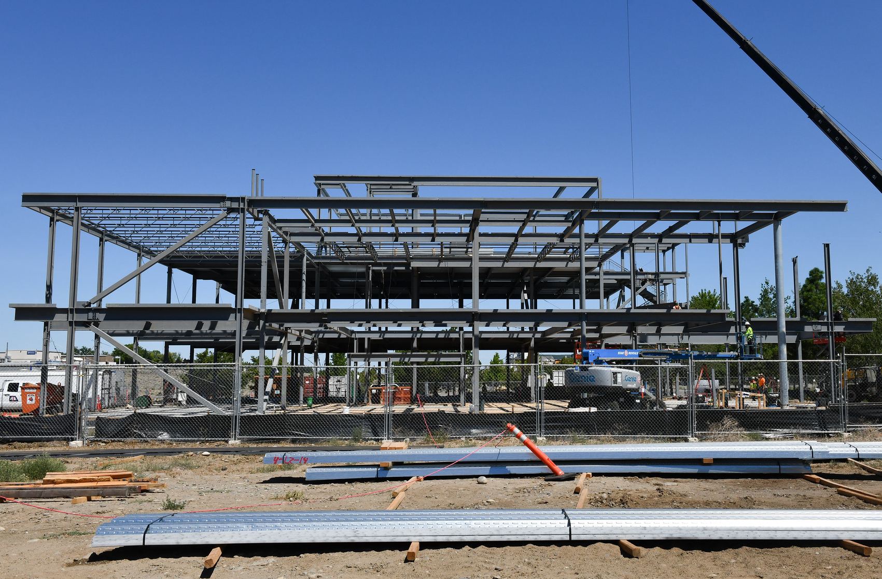
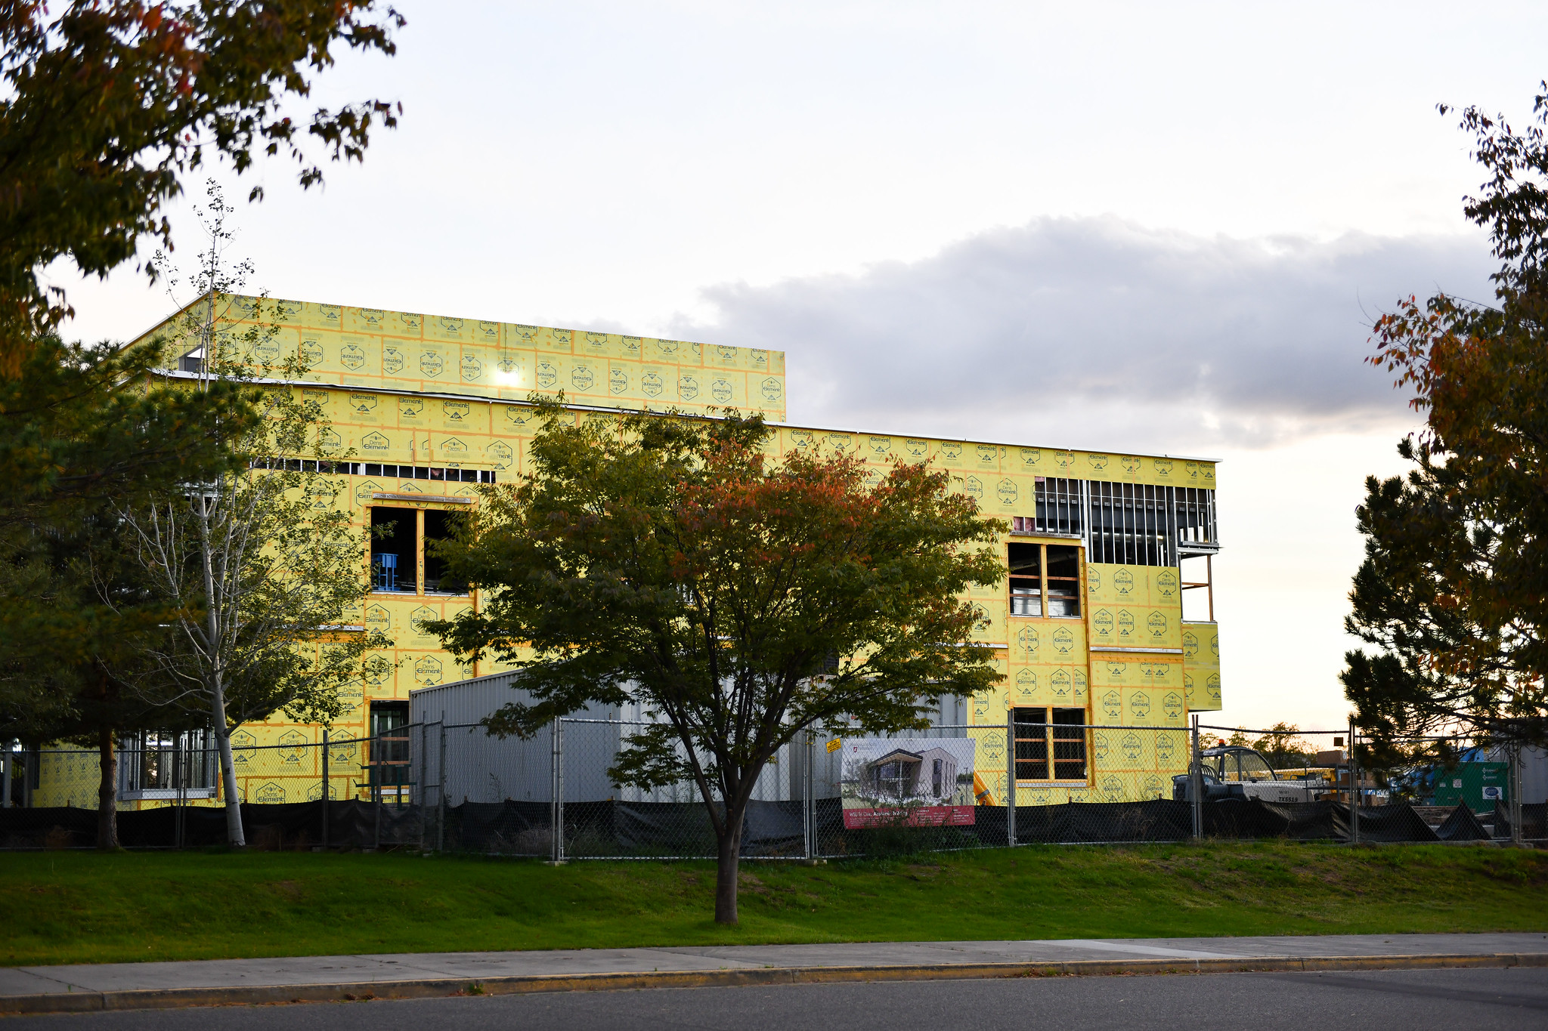
Academic Building
Notes:
When we are able to return to campus, and I hope I’m not going out on a limb here by saying next fall, we will have access to our new academic building. Drive by when you can. It is already re-shaping the look of campus and it will definitely re-shape our learning environment for students.

Slide 15

Library remodel
Notes:
We have also started to remodel the library into a Learning Commons and will continue to fundraise to complete this modernization effort. We recently engaged the talents of Karen Diller, Library Director and faculty member at WSU Vancouver with a specialty in library design, to help us create its best possible layout and use. I appreciate all the work from faculty and staff that has gone into this project to date from initial conceptualization to the beginnings of construction.

Slide 16
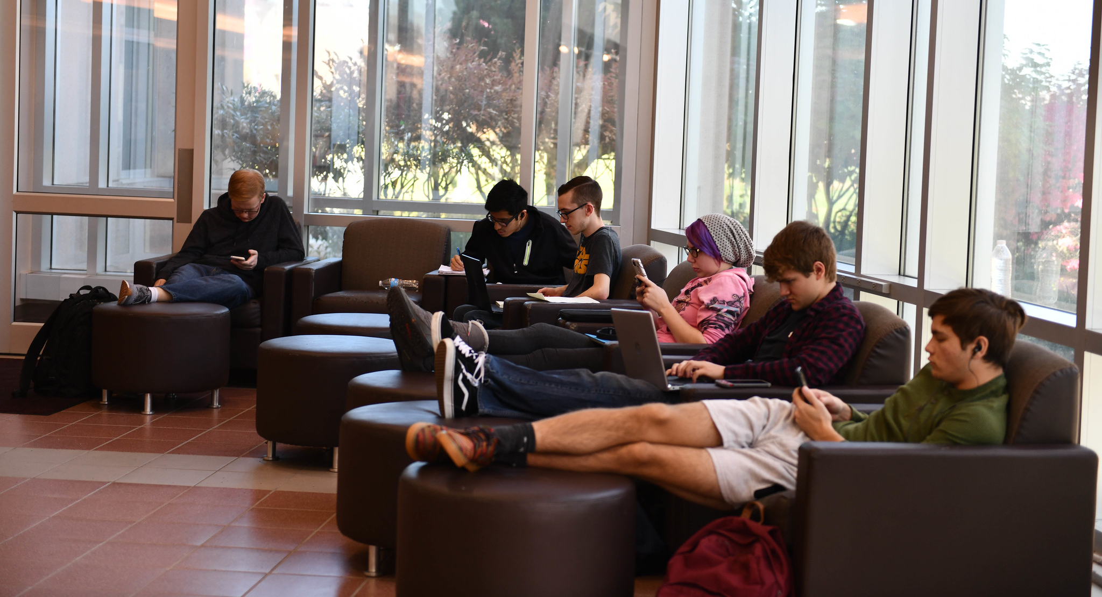
Other campus improvements
Notes:
And there are more on-campus improvements to report. The relatively empty buildings have enabled us to complete many items on our facilities project to-do list. In addition to deep cleaning classrooms, the long-awaited new whiteboards were installed in several classrooms throughout campus complete with the addition of projectors with interactive technology.
Sure to be a crowd favorite, the tattered chairs in the common spaces have been reupholstered and look like new!
And, finally, thanks to a $12,500 Soroptomist Club gift, we will be developing a new Wellness Lounge complete with a lactation room, bringing another building up to current construction standards in this regard.

Slide 17
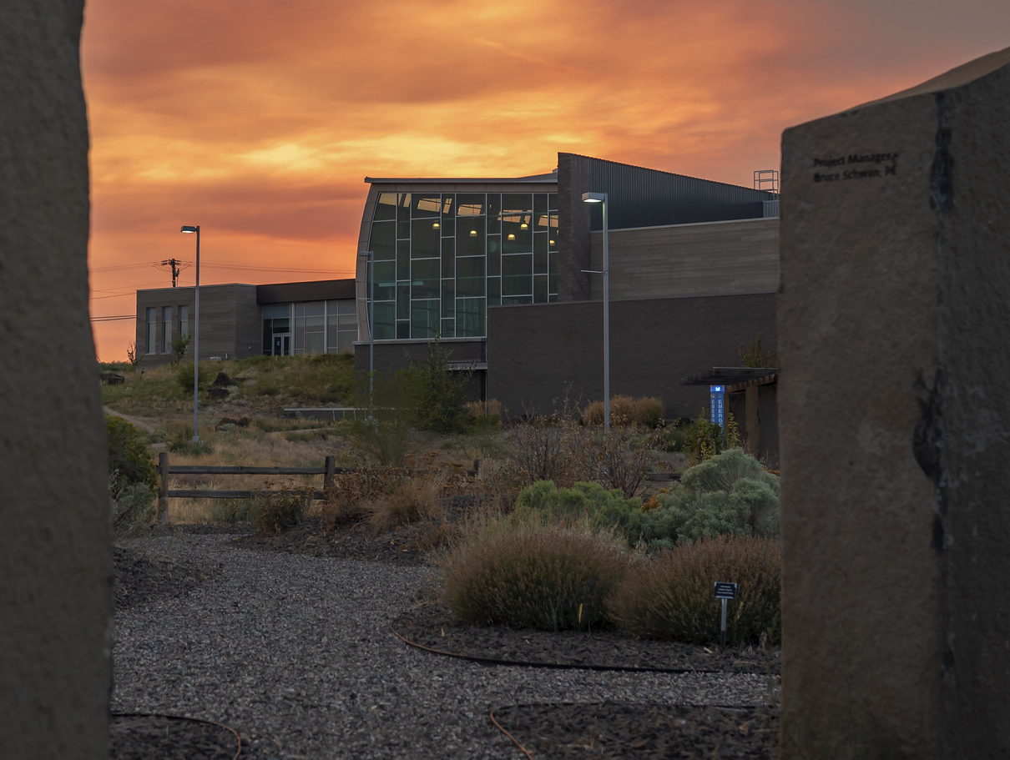
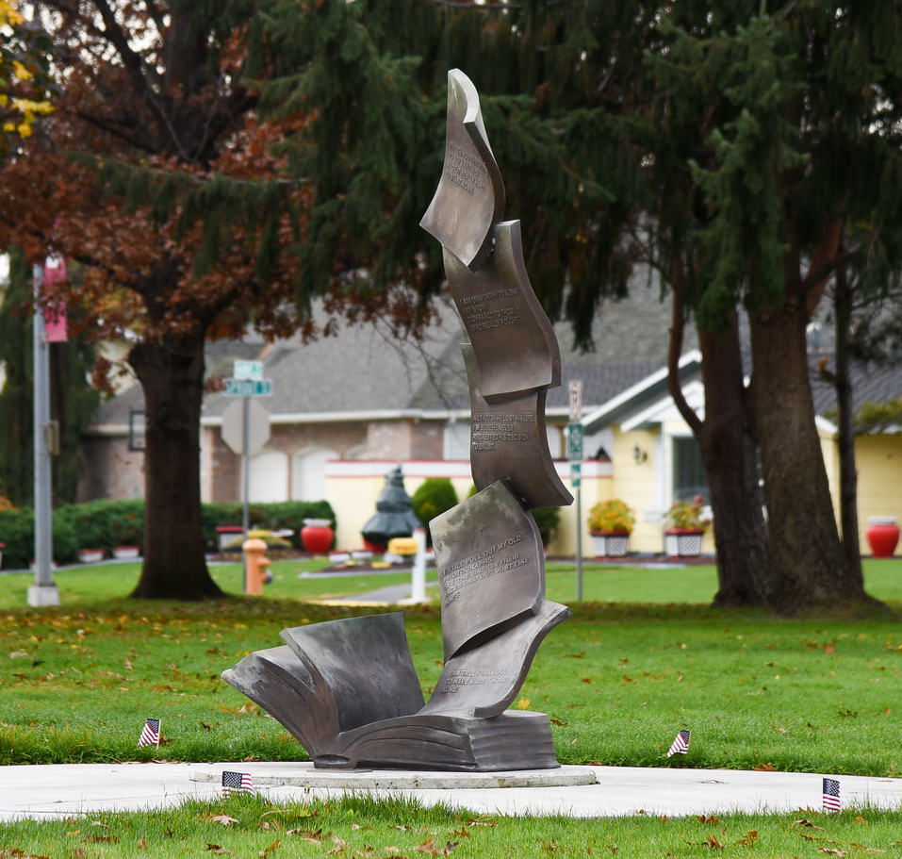
Indicator Garden | Veterans Memorial
Notes:
Outside, the indicator garden has been re-cultivated for the campus and community to enjoy.
And the veteran’s memorial, Stories, will be completed with a flag display demonstrating to the world that we are a Veteran-friendly campus.
Both projects were privately funded thanks to the efforts of Jaime Heppler and Kelly Gabel.

Slide 18


Electronic door locks and sustainability
Notes:
With ASWSUTC passing the safety and transportation fee referendum, we look forward to new safety initiatives and upgrades on campus. The first of these will be the addition of electronic locks to the exterior of our buildings, a project that is now underway. Creating more ecological practices will also be a focus of this how this fee is used to honor the our agreement with students who wish to have sustainability as a feature of the campus.

Slide 19
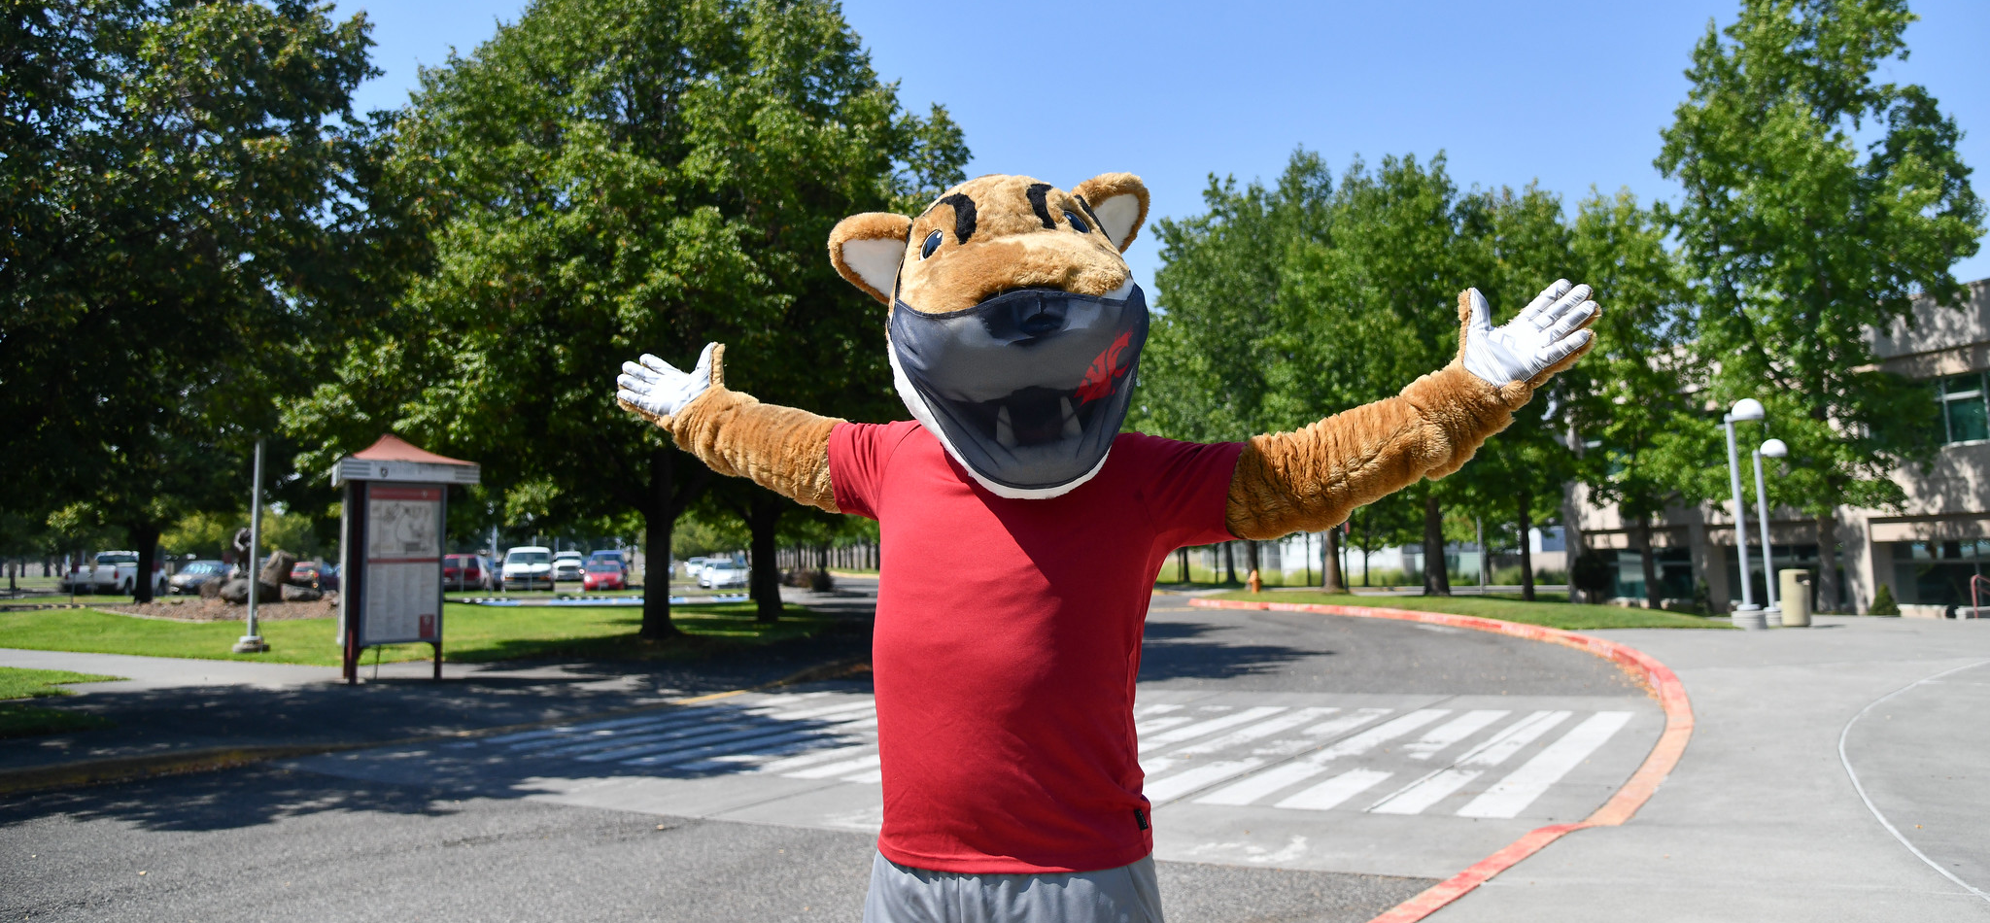
Butch T. Cougar finds home at WSU Tri-Cities
Notes:
And with the addition of Butch T. Cougar to campus, sustained by a $40,000 endowment in memory of Brad Fisher, pride in our campus will certainly surge! Again, we appreciate the input for these improvements from faculty, staff, and students.

Slide 20
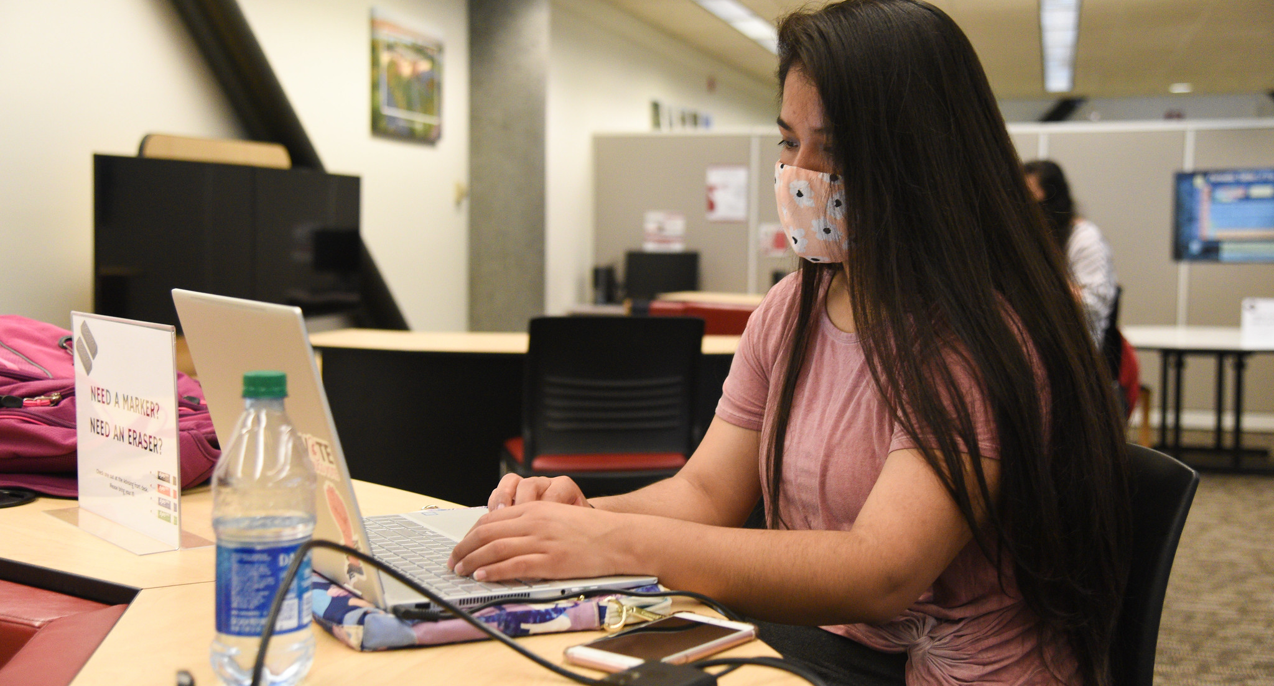
Classroom technology
Notes:
Knowing that we are not finished with virtual teaching and learning, and that, in fact, we are just starting to realize the power of virtual instruction for WSU in offering cross-campus courses and collaboration, our IT team has been improving classroom technology on campus. Zoom capability is available in all of our general use classrooms allowing for students to attend classes from a distance even when classes are held on campus. Using Guacamole, our new software application and not the yummy kind, computer labs are configured to allow students, faculty, and staff to access campus-located software from home. This is an important update for software accessibility and IT will continue to be available for technological assistance via WSU Tri-Cities virtual help desks to help with this and other technology issues.
I have to admit that I’m not sure what these changes will mean for snow days, but we’ll soon see.

Slide 21
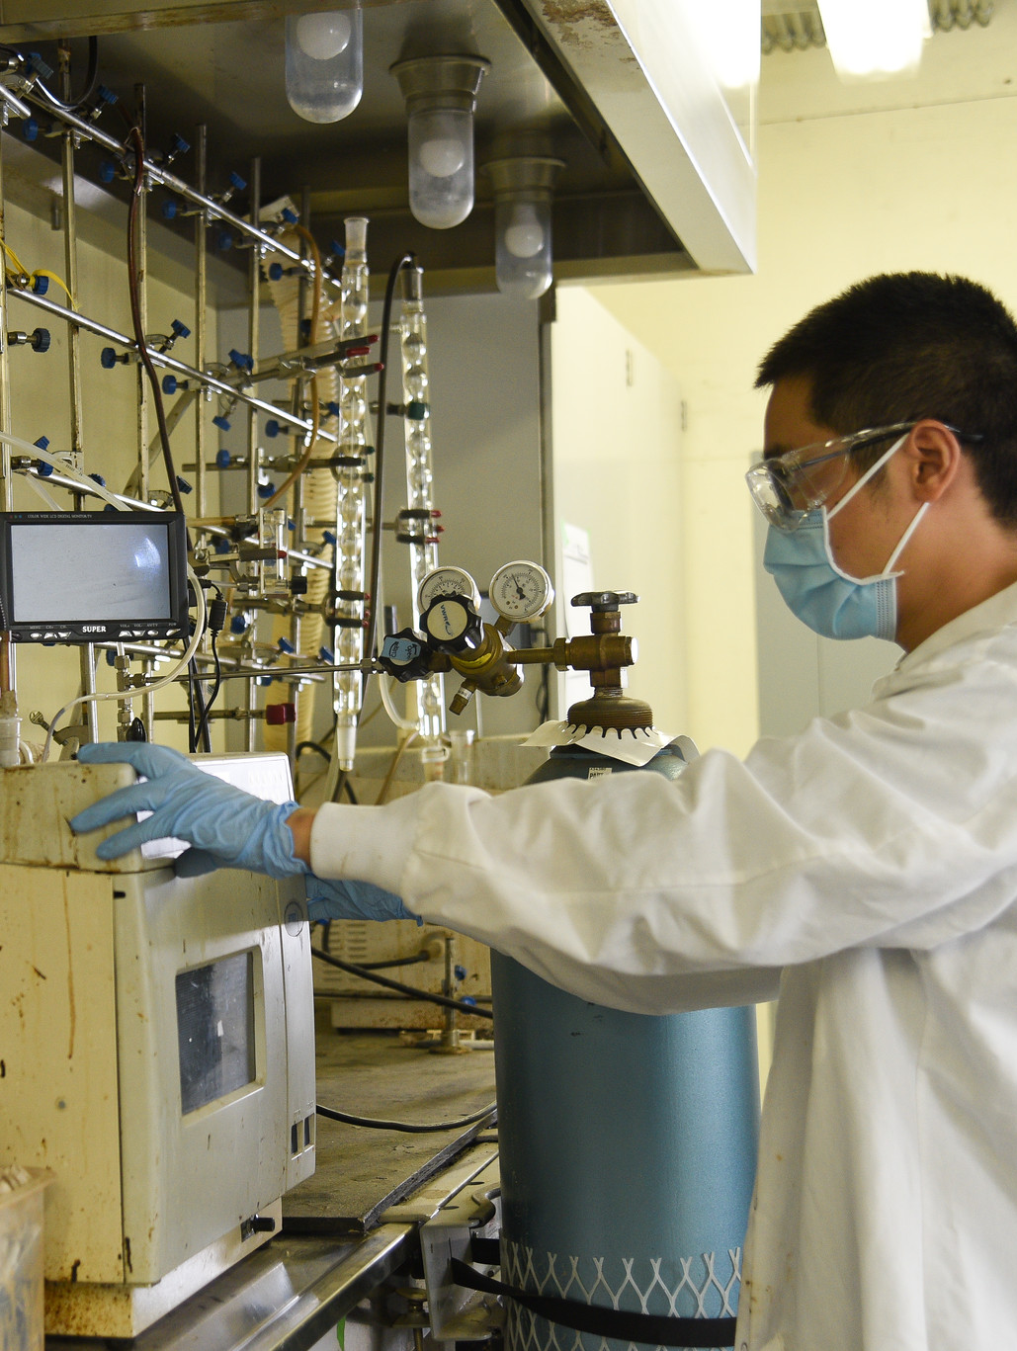
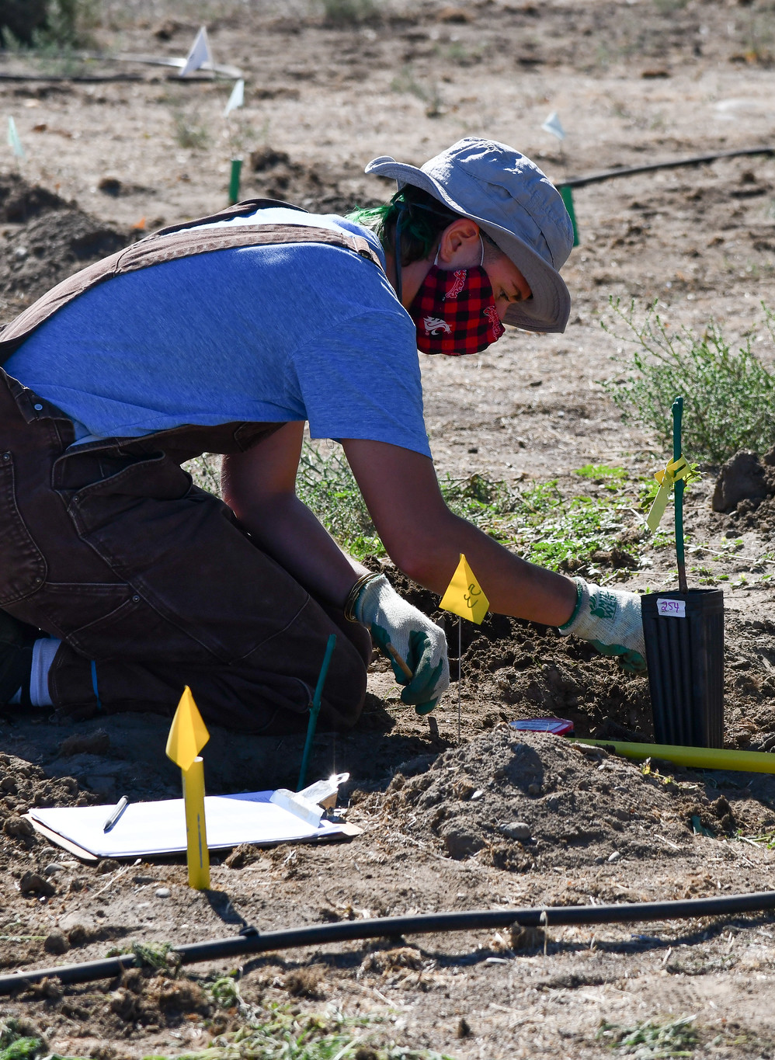
Research
Notes:
World-class research has continued on-campus by following the COVID safety protocols set forth by the Office of Research. Most faculty with research labs/spaces are back on campus conducting research but at low density at any one point in time. They are making sure safety protocols are in place to keep their research staff and graduate students safe. We appreciate the efforts everyone is making to safely conduct research activities on campus that are essential for the continuation of funded projects and for the progress of graduate students. The level of on-going research during the pandemic is variable across the campus as it is across the WSU system. Some people are back to almost normal productivity while others continued to be delayed because they cannot return to human subjects research as an example. We understand that each researcher is being affected differently by the pandemic and we are committed to providing everyone with the support they need.
Sarah Roley and her team have continued their research in how bacteria and grasses fix nitrogen.
Tanya Cheeke and her team have continued researching how a type of fungi may be used to support vineyard growth and health and for other means. She was awarded the WSU CANHRS BioAg Grant, which she used to look at grapevine growth and nutrient uptake of mycorrhizal (My COR e ZAL) inoculants.
Bin Yang, Hanwu Lei, Brigitte Ahring and Xiao Zhang have continued their respective research in biofuels, such as jet fuel, and bioproducts. Most recently, Dr. Yang was awarded the “Department of Energy and Office of Energy Efficiency and Renewable Energy” grant for his work on the conversion of jet fuels. Work on jet fuels at WSU, has helped lead to the recent development of Microsoft’s commitment with Alaska Airlines to use bio jet fuels in their company travel. This a powerful concrete example of how our faculty’s research impacts the world we live in.
Wine Science center faculty have continued wine production, and viticulture and enology research ranging from the effect of wildfire smoke on wine grapes, a growing issue in the Pacific Northwest as evidenced by the wildfires this past summer, to sensory components of wine, to vineyard health and growth. Both Tom Collins and Bhaskar Bon-da-da have been awarded prestigious USDA grants in their respective areas of research.
This spring, Judy Morrison and her team in the College of Education were awarded a National Science Foundation grant. They are partnering with local high school teachers and students to develop curriculum and hands-on projects that use geospatial technologies to improve STEM literacy.
WOW! You all have been hard at work. Thank you!

Slide 22
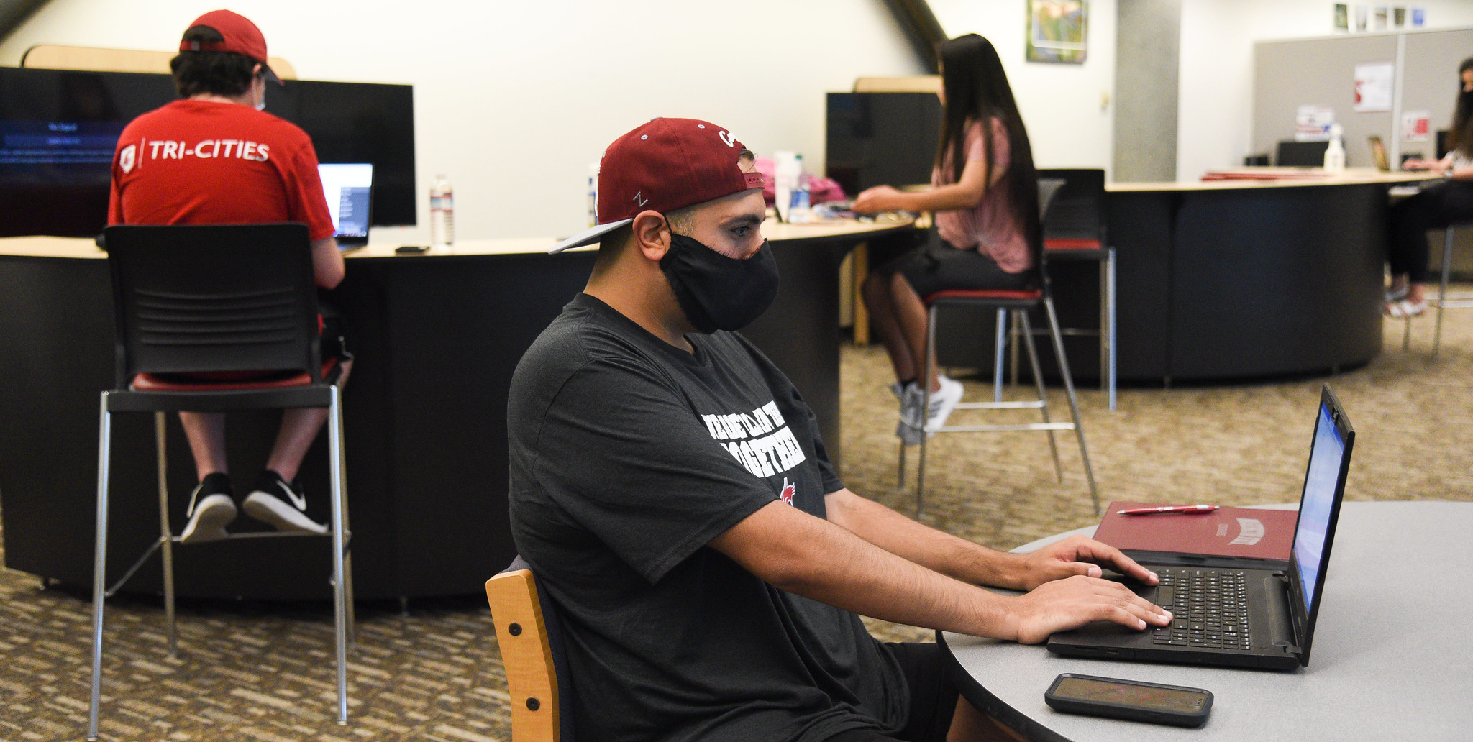
COVID-19 and plans for spring
Notes:
So, what’s to come for the Spring?
We can’t talk about plans for spring without understanding the context with regard to COVID-19 trends in Benton and Franklin counties. Despite being in Phase II of the Stay Home Stay Safe order, infection rates are, as predicted, on the rise. Thus, using infection rate data, the results of return to campus comfort level surveys from faculty, staff, and students that were largely inconclusive, and in line with the WSU System, WSU Tri-Cities will move forward with the following plans for spring semester:
The semester will begin on January 19, 2021, about a week later than originally scheduled. This strategically planned delay will give us time to assess the requirements from the U.S. Department of Education regarding use of distance delivery models for instruction and time to safely adjust to a new semester. The majority of classes will be taught virtually, and those requiring in-person elements, will be offered with the most up-to-date safety protocols in place to help ensure the health of our students, faculty, and staff. As it is now, wearing masks will be mandatory and we will assist with this by providing the 20,000 disposable face masks for those on campus that were donated by Lamb Weston and using the 50 gallons of hand sanitizer that was donated by Goose Ridge Winery. A big thank you to our donors and development staff for these safety tools.
In an effort to reduce non-essential travel, the University will replace the traditional spring break that occurs in March, with a series of mid-week academic days off scheduled throughout the semester. These breaks will be on February 25th, March 17th, and April 13th. A class holiday will also take place on Presidents’ Day, February 17th. To ensure true time-off on these mini-breaks, faculty will not set due dates on these or the following day. Likewise, take home exams will not be given over the mini-breaks. Similarly, faculty and staff meetings will not be scheduled on these dates except for the optional AOI trainings that are provided every year on the President’s Day class holiday.
It is essential that we continue to do everything we can to reduce the spread of COVID-19 in order to return to the in-person WSU Tri-Cities experience that we all desire. These measures will help us in achieving that goal! And, they will help us to reach our other goal, and I’m knocking very hard on wood here, of holding commencement in May 2021, yes, at the Toyota Center. Fingers crossed!

Slide 23
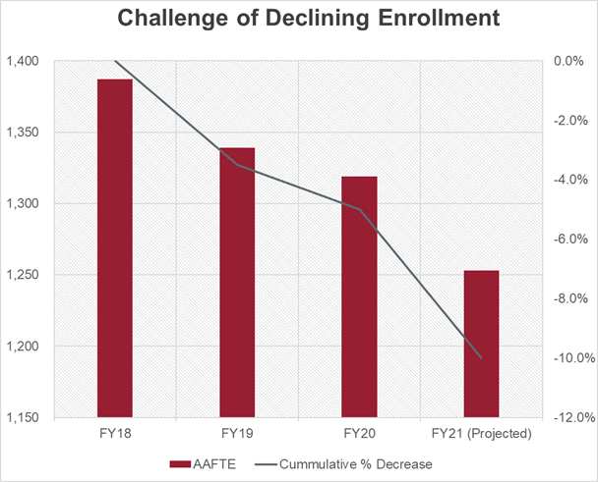
Notes:
Alas, COVID-19 and the resulting schedule changes are not the only challenges for Spring and beyond. It’s no surprise that the interrelated issues of student enrollment and budget continue to be difficult for campus. Because we need to turn these trends around, enrollment and budget are two of the three areas of priority we will use to determine the viability of implementing future initiatives.
Let’s look at the status of enrollment. Fall 2020 enrollment was down 5.3% from Fall 2019. This drop for Fall 2020 was not unexpected, as national trends for universities show a 4% decrease in overall college enrollment, an 8% decrease for transfer students, and a 16% decrease for freshman in 2020. For WSU Tri Cities, this compounds the decline in enrollment of 1.5% in fall 2019 compared to fall 2018 and a 5% decline in enrollment between fall 2017 and fall 2018. Our current numbers represent a decrease from a high of 1,937 students to our current headcount of 1,716 students.
Recall that for every percentage point drop in enrollment, the campus loses $100,000 in tuition. This means that over the past four years, we have lost over $1M in annual revenues. If we continue on this trajectory and assume no adjustment to our state allocation or tuition increases, in three years our enrollment and budget will look like this: SLIDES.
Many of you may be wondering what this outlook means to you. When were asked to anticipate a 10% budget cut across the WSU system this year, the Tri-Cities leadership team worked very hard to preserve current jobs and will continue to do so. Although our needs for additional faculty and staff are great, only essential hiring will be made during the current hiring freeze. We are being very conservative with our reserves and the initiatives we implement and are working hard to create more efficiencies by using staff time and talent in the most effective manner. Processes are being examined to identify and reduce unnecessary work and some jobs are being restructured, for example in Academic Affairs. These changes reflect an effort to protect jobs for our current employees.

Slide 24
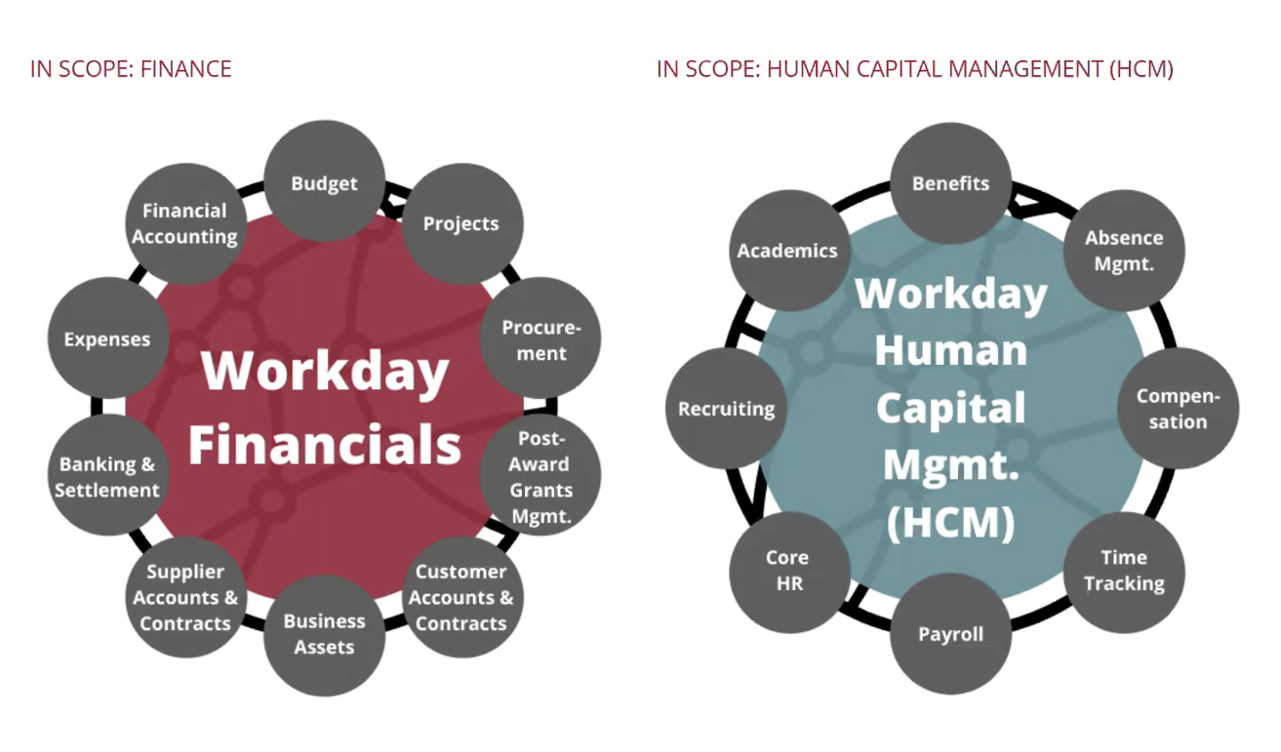
Notes:
One way in which the entire system will gain efficiencies is through implementation of the Modernization Project, Workday. University-wide training started this month and I can’t encourage you enough to take the training ASAP! We will all be using this platform starting January 1st. I want to thank the people who are doing the difficult upfront work to start the transition for us: Robin Stanco and Damien Sinnott as project leaders, super users Christopher Cree and Molly Levy, and our change agents, Cheryl Jensen, Timothy Larreau, and Chris Meiers. I recognize that a change of this size will continue be a heavy lift at the outset but make life much easier in the long run. Good ridance to blue screens and paper time sheets!

Slide 25
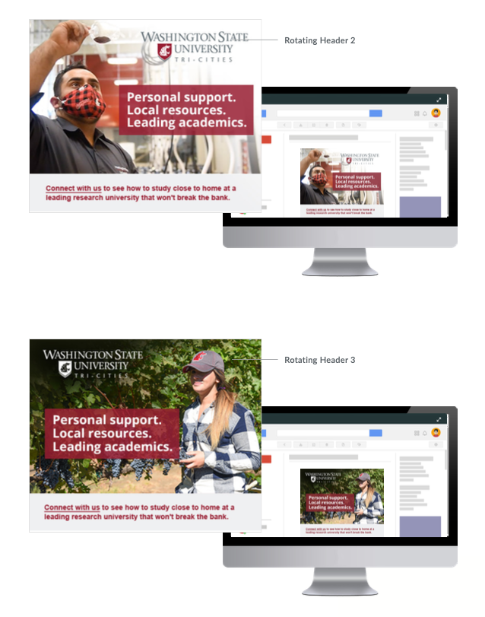


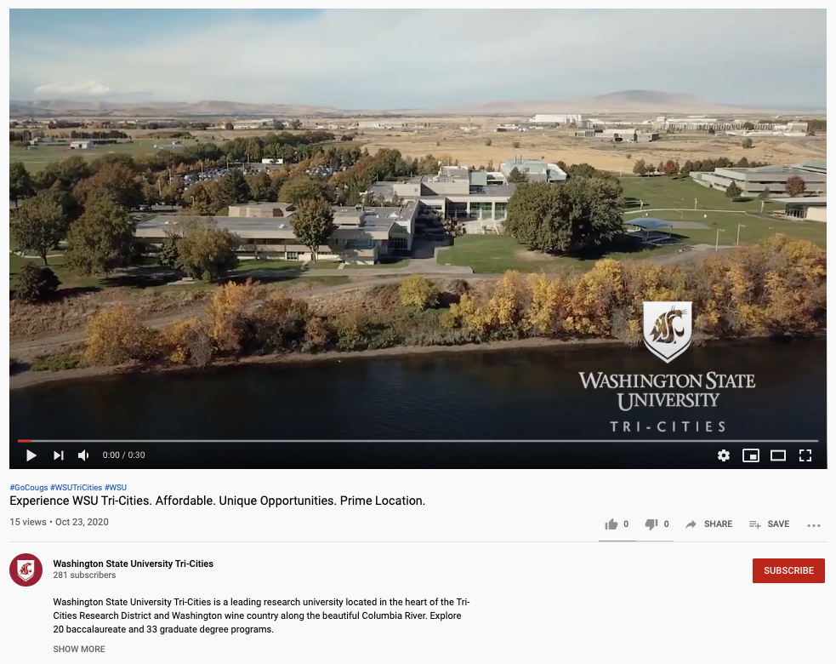

Recruitment Campaign/Enrollment
Notes:
Please be assured that we are taking aggressive steps to reverse the enrollment trend and know this is an all hands-on deck effort. Here is an overview of our current recruitment and retention efforts.
Provost Elizabeth Chilton is in the process of hiring a Vice Provost for Enrollment Management as a system-wide position. This individual will be charged with increasing enrollment for WSU regardless of location. Having this position should be a tremendous help in increasing enrollment and reducing competition for students that we sometimes see with the Pullman campus.
Our contract with Ruffalo Noel Levitz is in its second year of search strategy with the Demand Builder, which is focused on increasing size and quality of the pool of students inquiring about admission to WSU Tri-Cities. This includes name buys, targeted email and print campaigns, and digital social media strategies.
A centralized Customer Relationship Management program called “Slate” has been implemented. This platform allows for more consistent communication with the students inquiring and applying for admissions and includes a texting and event management platform.
WSU Tri-Cities marketing and communication launched an extensive campaign featuring a range of advertisements and videos that market WSU Tri-Cities degree programs and highlight affordability statistics and access information. These appear on social media, YouTube, and Google. You will also see a series of student profile videos airing in November that highlight specific programs including the wine science program, the wine and beverage business management major, computer science, and the digital technology and culture major.
Lastly, as a system, WSU is moving to “test blindness” in admissions. This means that we will not consider standardized test scores for any admissions decisions or scholarship awards. This should increase our application completion rate and ultimately our pool of potential students.
To help current students progress, Academic and Student Affairs have implemented Ad Astra Platinum Analytics, which is a scheduling efficiency software that analyzes historical trends to project course need. Using this efficiency measure, we should see a decrease in our excessive dependence on adjunct faculty, a decrease in disruptive class schedule changes, and a decrease in cancellation of low-enrolled courses. Jessica Bland has joined the registrar’s office for all things scheduling making this process even more efficient.
Vice Chancellor for Academic Affairs, Kate McAteer, is also working with academic directors on an academic plan to determine if we have the right mix of programs on campus. In these ways, we will be better able to ensure that we are offering the right programs with classes at the right time for students. As part of the effort, a hiring plan for full-time faculty will also be developed and ready for implementation when budget allows.

Slide 26

Bridges Program – Transfer from CBC to WSU Tri-Cities
Notes:
An agreement with Columbia Basin College to redevelop our “Bridges” program is nearing completion. Bridges provides a seamless process designed to serve the needs of students in the Tri-Cities and surrounding communities to reduce many of the barriers that can occur for transfer students upon matriculation into our four-year university. The campus is also working with CBC to build out joint marketing, joint campus resources to assist with transferring from CBC to WSU Tri-Cities, and additional joint programming such as the recent virtual career fair.

Slide 27
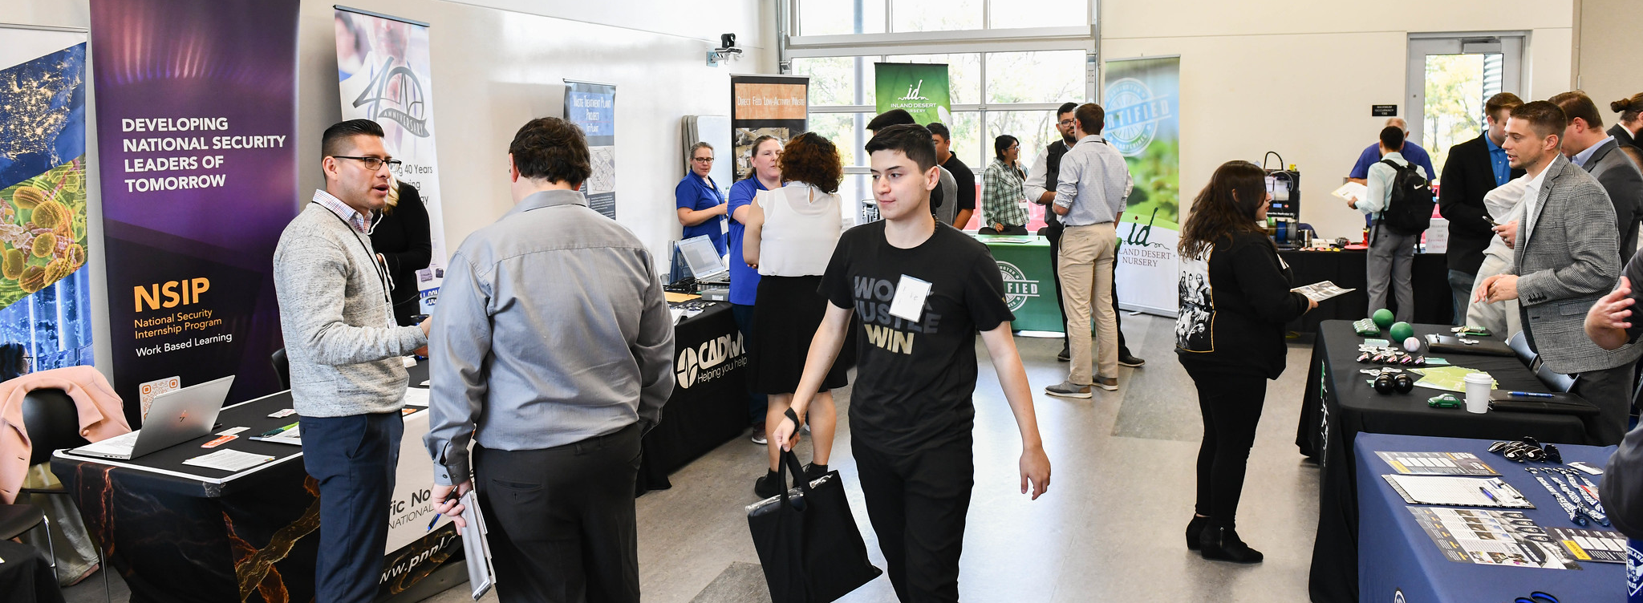
Statewide Internship Portal
Notes:
Coming soon—and you heard it here first—the Tri-Cities will become a pilot site for a State-wide internship portal. WSU Tri-Cities, CBC, and the Tri-Cities Chamber of Commerce have teamed up to be one of two pilot sites for this initiative. The portal should make it easier for students and employers to connect regarding potential internship opportunities in the Mid-Columbia area and across the state. This “match-making” service stands to make the process of obtaining an intern and seeking an internship easier by offering a one-stop shop for companies and students. The portal will help make WSU Tri-Cities an attractive location for those wanting hands-on and industry experience as well as getting the WSU Tri-Cities brand in the names of industry partners across the state. High impact practices such as participating in internships are key to student success in college and will help with student persistence.

Slide 28
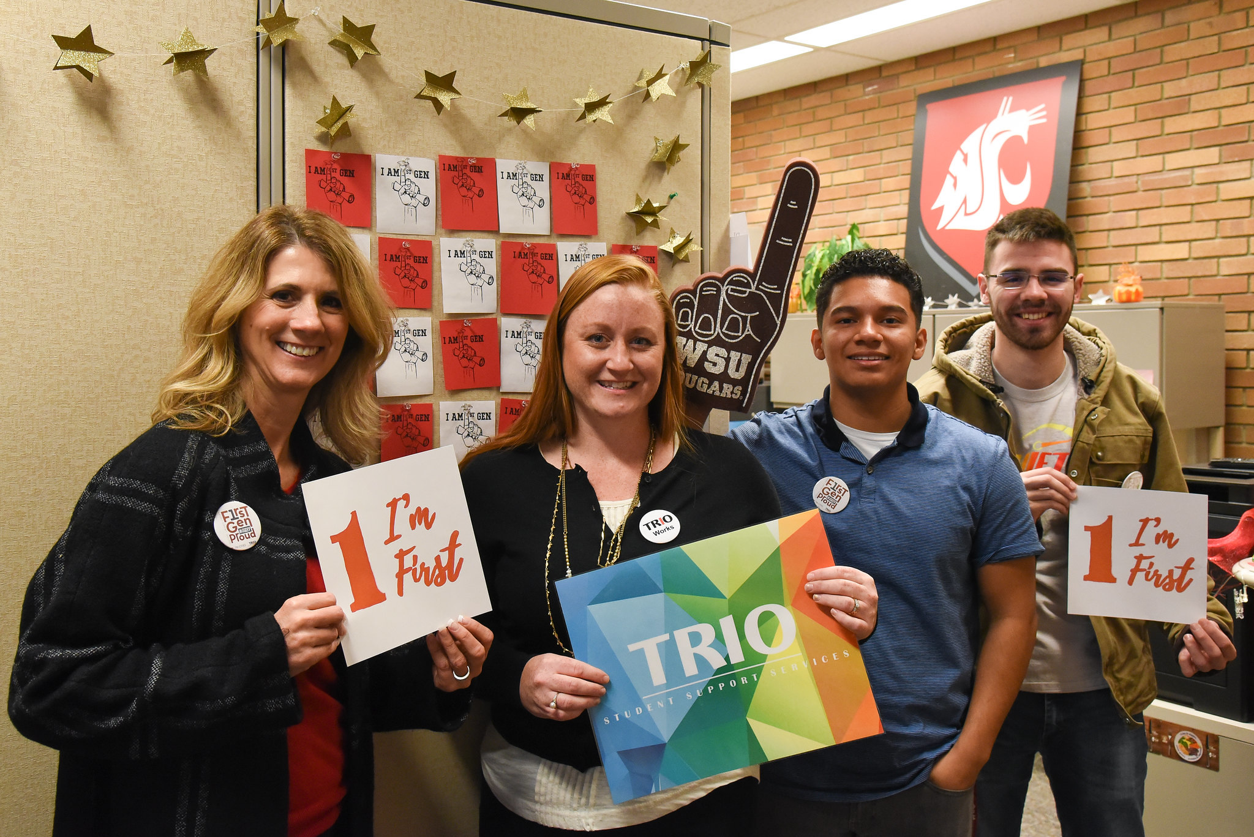
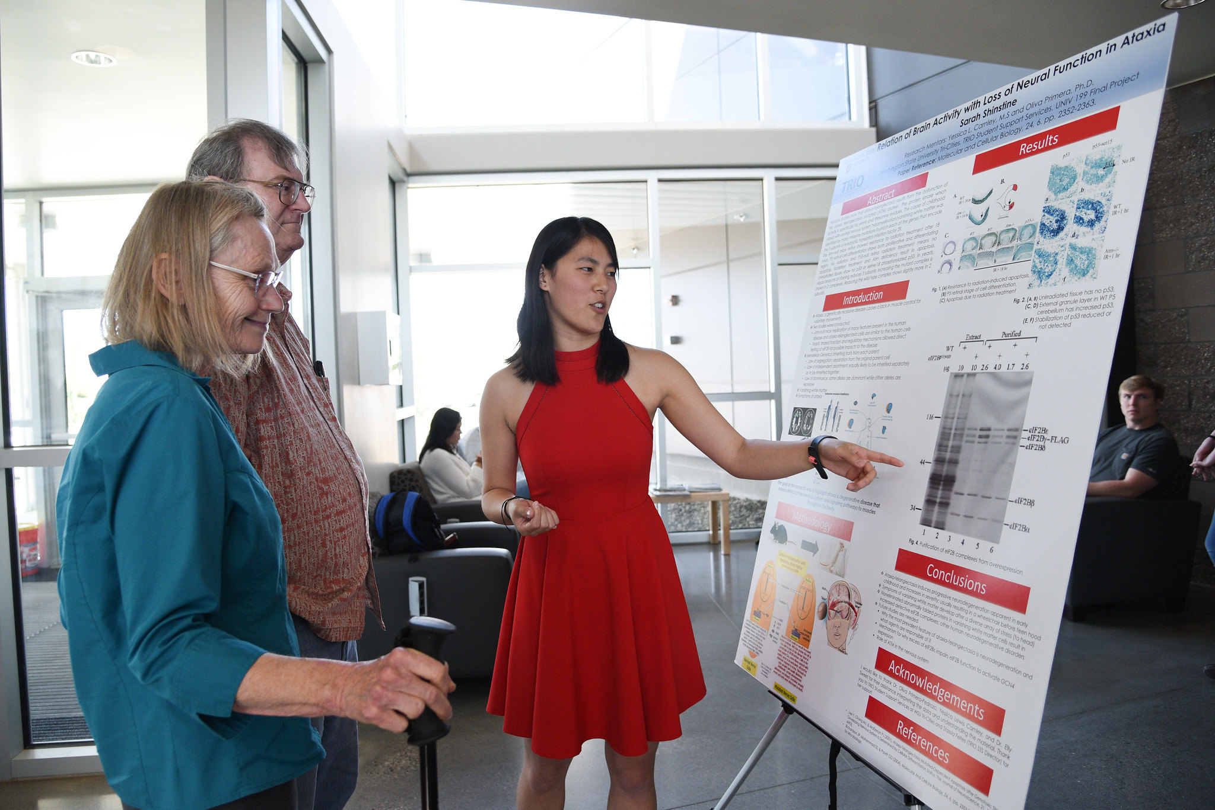
TRIO Student Support Services
Notes:
Realizing the importance of student support in persistence, Academic Affairs applied for and was recently awarded two grants from the Department of Education: a 5-year renewal of the TRIO Student Support Services grant to support 120 students and another 5 year TRIO STEM grant to support another 120 students pursuing a degree in a STEM major or who are in a pre-health program. This will help us continue and build out TRIO, a program that supports tutoring and mentorship services to students from disadvantaged backgrounds.

Slide 29
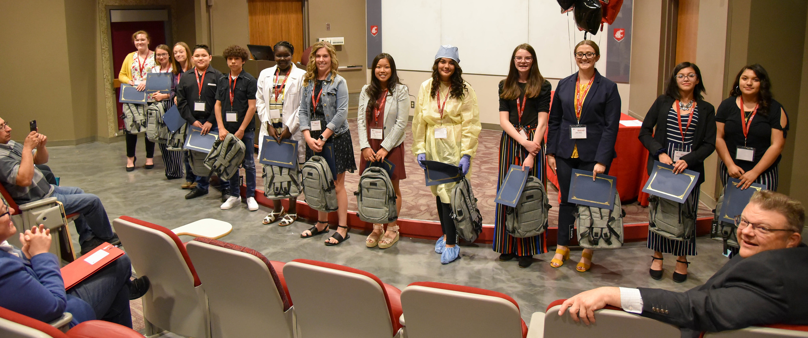
GEAR UP – Supporting college readiness for K-12 students
Notes:
Additionally, the GEAR UP program was awarded two new grants that will serve regional school districts, as well as several schools in the Vancouver area. The grants benefit close to 4,000 students, each. These grants total $23 million and $20 million, respectively. With these two additional grants, the GEAR UP program will have served more than 35,000 students in preparing middle school and high school students for college since 2002. Congratulations to the K-12 and GEAR up teams!

Slide 30
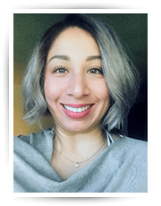
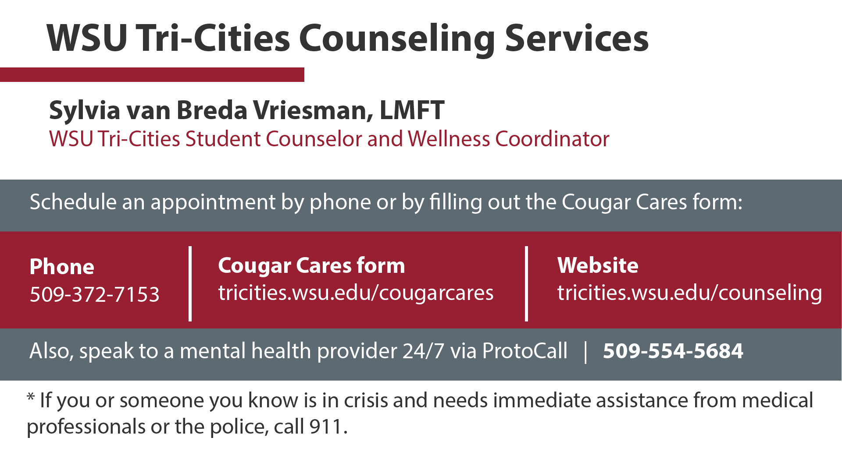
Silvia van Breda Vriesman
Student Counselor and Wellness Coordinator
Notes:
During this stressful and uncertain time, ensuring access to resources for student’s basic needs is of great importance. As a national statistic, symptoms of mental health conditions are high in college student populations and have been exacerbated by the pandemic. Understanding the need for access to mental health resources, I am pleased to announce that we have hired a new full-time mental health coordinator, Sylvia Van Breda Vriesman (VREES-man). She will serve as the mental health coordinator for the campus working directly with students and with faculty and staff on programming, consultation, and trainings related to supporting students as well as developing more awareness of mental health issues, stigma reduction, and overall “wellness” of our student body.

Slide 31

MOSAIC Center for Student Inclusion
Notes:
Likewise, the MOSAIC Center for Student Inclusion continues to provide critical support to students through various programs including supporting the Community Classroom series. This series of programs was designed to educate about and bring to light issues of individuals from underrepresented backgrounds.

Slide 32
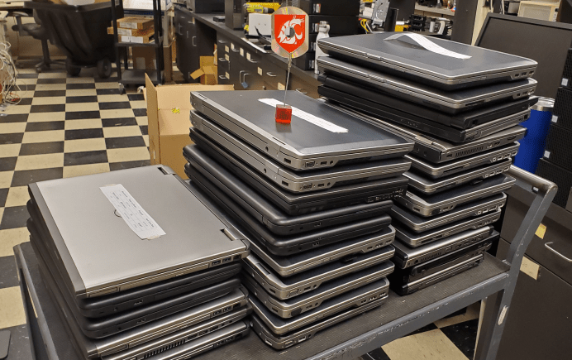
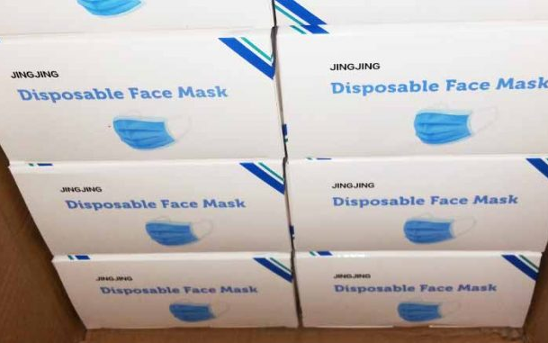
Fundraising
Notes:
We have had tremendous success with fundraising for the student hardship fund and continue to pursue this as a priority in fundraising efforts. We received a $30,000 gift from Batelle for this fund, $25,000 from STCU, and several other donations that assisted with increasing the revenue needed to help students with unexpected financial difficulties. And we also addressed student's technology needs with a donation from Cadwell Labs of 30 nearly new laptops to add to the cache of laptops in the campus’ laptop loaner program championed by ASWSUTC and student affairs.

Slide 33
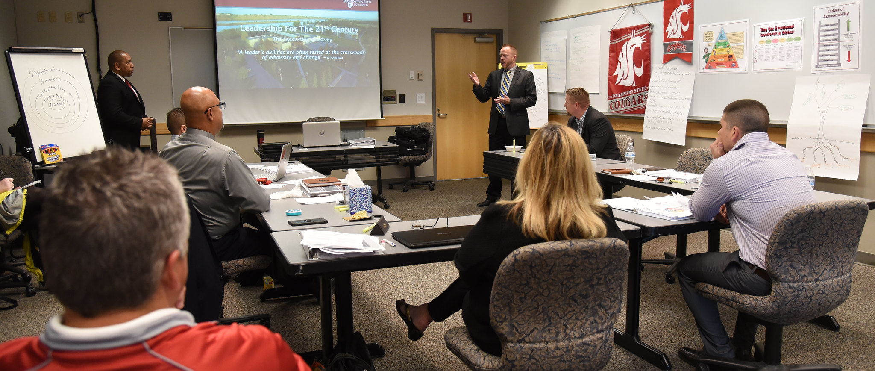
Continuing and Professional Development
Notes:
These and other efforts should help us stem the tide of decreasing enrollments and the resulting drop in funds needed to serve our students. To further increase our operating revenue, we are looking at generating other sources of income as well. These include creating a division of corporate and professional education to work with business, hospitality, education, and the Hanford Contractors to provide high-quality, WSU branded courses to meet workforce education needs. Joan Giese is heading up these efforts. Likewise, Philanthropy is on the rise and our own advancement team is raising the bar for giving from alumni, the community, and beyond.

Slide 34

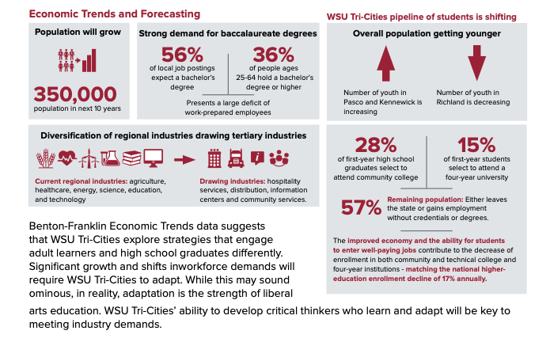
Strategic Plan
Notes:
While it is easy to get bogged down in the here and now of the pandemic, we must look forward in order to emerge stronger. And, at WSU Tri-Cities, we most certainly will emerge stronger. Our strategic plan, 2 years in the making, is complete. It will serve as our guide to the future, a future that will include meeting the needs of the Mid-Columbia Region in educating the populace, but also tackling the area's most pressing economic and environmental issues. Look for the campus to move toward being a leader in energy, specific agricultural areas, and the environment. These three economic drivers have sustained the area and will be of even greater importance in the future. To truly be “in the community,” we must make greater efforts to be “of the community.” Focusing on these three areas will give us a sense of identity unique and essential to the area in which we live and work. These efforts will help us secure a much-needed brand identity, the third priority area we will use in determining which initiatives to undertake.

Slide 35
Distinguished Excellence Awards
Distinguished Teaching Award
Distinguished Research Award
Outstanding Adjunct Faculty Member
Chancellor’s Distinguished Employee Excellence Award
Distinguished
Excellence
Award
Notes:
Before I move to closing, I would like to announce four distinguished excellence awards that have been created for faculty and staff. We present these awards as a way to more formally recognize the hard work that our faculty and staff contribute to the campus. The first award is the WSU Tri-Cities Distinguished Teaching Award. This award will be given each year to a faculty member, or a group of collaborating faculty, who demonstrate excellence in teaching. A second award is the WSU Tri-Cities Distinguished Research Award. Like the first award, this award will be given each year to a faculty member, or a group of collaborating faculty, who demonstrate excellence in research. The third award will be given to an outstanding adjunct faculty member. This award was endowed with a donation from former Interim Vice Chancellor for Finance and Administration, Peter Smith, who recognized the importance of adjunct faculty to our campus. The fourth award, The Chancellor’s Distinguished Employee Excellence Award, will recognize an employee with outstanding contributions to WSU Tri-Cities in one or more areas of our strategic plan. Specific eligibility and nomination criteria will be distributed shortly.

Slide 36
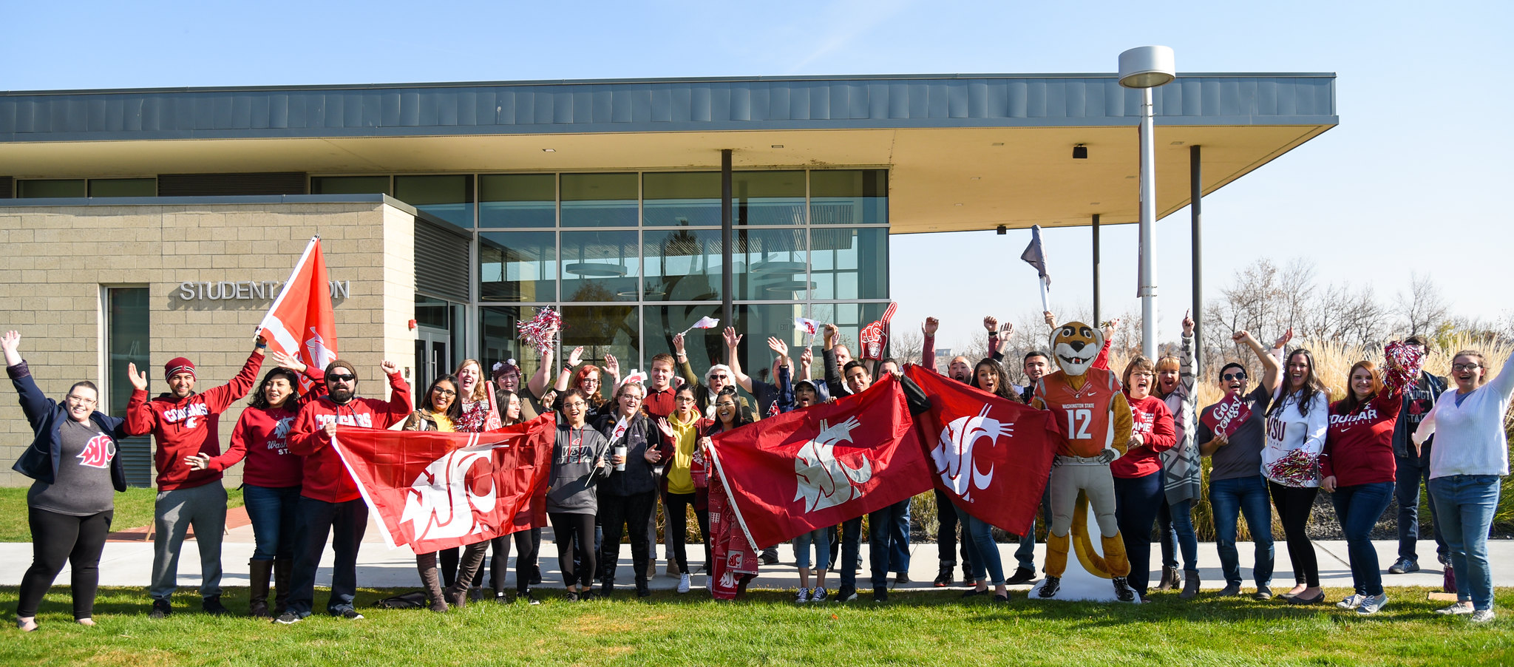
Educating our state’s future
Notes:
In closing, I would be remiss not to acknowledge that many of us are experiencing the inevitable fatigue resulting from dealing day in and day out with the pandemic. It is easy to get discouraged and wonder why we even continue doing what we do. But therein lies the answer to combatting that fatigue—our why. Daniel Golman’s groundbreaking research on Emotional Intelligence tells us that the best way to combat ambiguity is to hold on to a deep sense of purpose. Philosopher Viktor Frankl and Psychologist Martin Seligman have demonstrated that a deep sense of purpose and meaning can carry us through the most difficult of circumstances. At WSU Tri-Cities, our purpose is in our mission of education, scholarship, and service. I want to close with a reminder to take care of yourself and each other during this time. It is crucial especially when the boundaries between our professional and personal lives are so blurred. Although both have meaning and purpose, without separation they can cause greater stress and fatigue. As for me, I want to thank you for your company on this journey of serving our community. My work and yours is full of purpose and it is a joy to share it with you. Thank you for your time today. And, don’t forget to wear a mask and wash your hands.

